Slide 1


Wine Retailer Case
MSMA Team 15
Wanyu Cheng, Yuying He, Yi Huang, Tianyao Liu, Jing Zou

Slide 2

Summary and Key Findings
Overall, the email campaign generates a significant increase of $1.26 on wine purchase, shown by the average causal analysis.
Slicing and dicing analysis shows that email campaign has different effects on different slicing segments.
By measuring effectiveness of email marketing through average open rate, click through rate (CTR), and conversion rate, we found that purch_chard and past_purch are the two variable that could most effectively split customers, and we should target chard segment and big volume purchasers.
Causal forest analysis predicts that 55.79% of the training sample should be targeted by email.
In order to improve effectiveness of email marketing, our store could optimize email content with wine brands such as Chard.
Notes:
The company does not target customers with specific purchasing behavior (for example, more frequent buyers or people who visit more) to send email campaigns, which leads to ineffective targeting of email marketing. After slicing and dicing analysis, we found that segmentation using different variables would make the email campaign more effective.

Slide 3
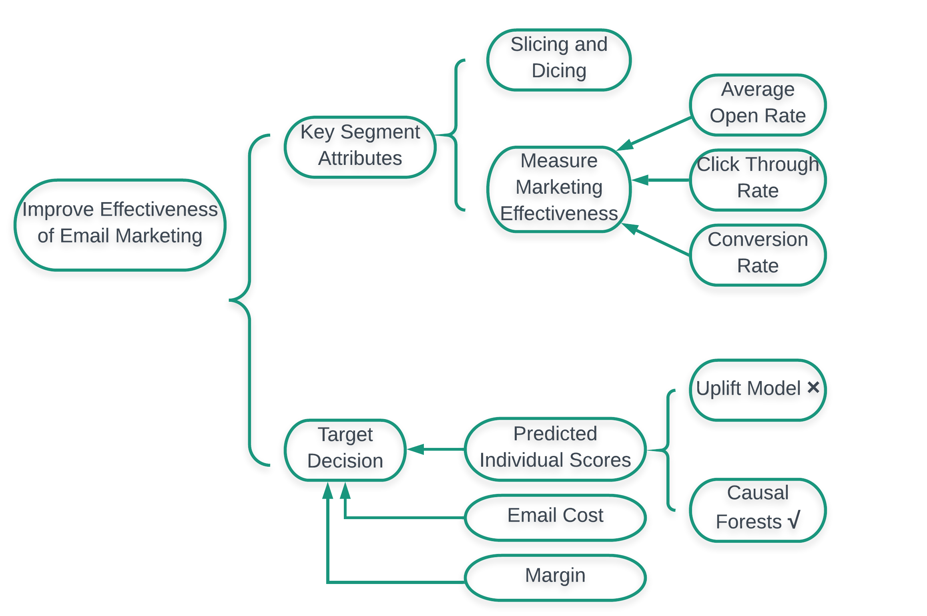
Analytic Methodology
Notes:
Analytic Needs: to improve effectiveness of email targeting
Analytic Goal: we used causal & predictive analysis (for example experiment and causal forests)
Average Causal Effect & Slicing and Dicing :
To get average causal effect among the whole population.To get average causal effect among the whole population.
Slicing and Dicing: To segment population with 7 base variables and test statistical significance.
Target decisions are based on three indicators:

Slide 4
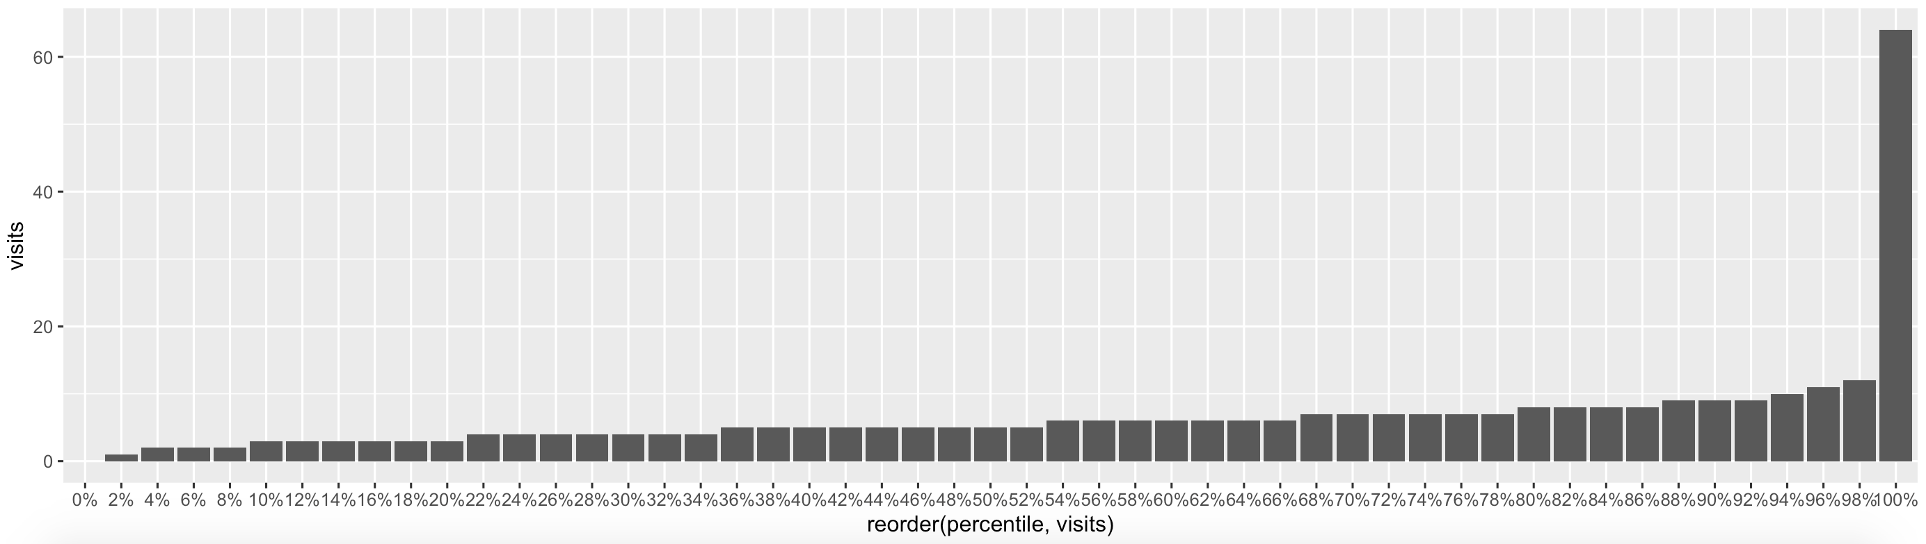
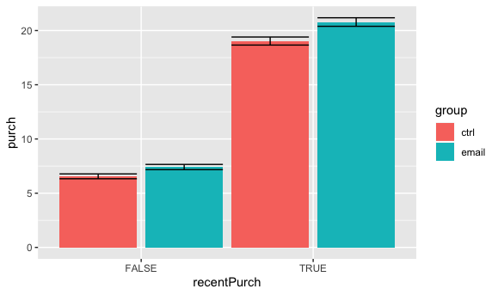
Average Causal Effect and Slicing and Dicing Analysis
ACE Analysis
purch ~ group
The main effect analysis shows an effect size of $1.35 on purchase.
purch~group+chard+sav_blanc +syrah+cab+last_purch+visits
By adding variables, we improved precision of estimates. The effect size of email is $1.26.
Variables | Slicing Criteria | Takeway from dagg table
pastPurch | past_purch > 53 | more effective for higher accrued past purchase
recentpurch | last_purch < 63 | recent buyers
frequency | visits > 5 | non frequent buyers
purch_chard | chard > 0 | purchased chard
purch_sav | sav_blanc > 0 | purchased sav
purch_syrah | syrah > 0 | did not purchase syrah
purch_cab | cab >0 | purchased cab
Slicing and Dicing for CCE Analysis
Select 7 baseline variables for slicing and dicing
Choose median as the criteria for 3 variables with skewed distribution
Ex: ‘last purchase’ has mean 90 days, median 63 days, highest 2% distribution with values > 1000 days.
*See Appendix Page 9 and Appendix Page 10 for Full Graphs
Notes:
lm(formula = purch ~ group, data = email)
we use following regression to include
lm(formula=purch~group+chard+sav_blanc
+syrah+cab+last_purch+visits,data = email))
By controling
lm(formula = purch ~ group + chard + sav_blanc+ syrah + cab + last_purch + visits, data = email)
Email improves overall effects by 1.26

Slide 5
Conditional Causal Effect
Variables | Interactions | coef | P-value
past purchase | pastPurchFALSE: email | 0.9903 | 0.02728
 | pastPurchTRUE: email | 1.5945 | 0.00038
recent purchase | recentPurchFALSE:email | 0.8576 | 0.0551
 | recentPurchTRUE: email | 1.7523 | 8.92e-05
frequency | frequencyFALSE: email | 1.4960 | 0.000712
 | frequencyTRUE: email | 1.1707 | 0.011154
Marketing Effectiveness Measurement Matrix
*purch_chard and past_purch are the two effective baseline variables; retailer should target chard segment and big volume purchasers.
Chard Segment
Open rate: 73.50% 93.80%
CTR: 17.32% 16.16%
Conversion Rate: 37.11% 54.27%
Non Buyer Buyer
Insights from Regression & Significance Tests
Ex. Bigger volume customers tend to have higher average purchases ($10.45), comparing to smaller ones.
Ex. Bigger volume customers are more affected by email, leading to additional $1.59 in spending.
Past Purchase
Open rate: 65.96% 93.06%
CTR: 13.58% 19.25%
Conversion Rate: 31.40% 48.60%
Small Volume Big Volume
Notes:
Select 7 baseline variables for slice: controlling variables for frequency, past purchase, recent purchase and 4 categories.
Observing variable mean, median and tendency distribution, we choose median as the criteria for slice. for example, for variables “ past purchase”, the mean value is $130.6, median value is $53, and according to tendency distribution, only last 2% values are more than $100. so we set median 53 to evaluate whether this customer has a large past purchase amount.
Regression on 7 baseline variables and check if slice using these variables would lead to significant and economically meaningful differences in causal effect.
check the coefficients of regression for each variables to see if this there is significantly difference between control and email group.
1. Subgroups vary in how much they engage in behaviors
Big volume buyers tend to have $10.45 higher average purchases in the future
2. Subgroups vary in how much they respond to treatments
Big volume buyers are more affected by the email, leading to addition $1.59 in spending

Slide 6
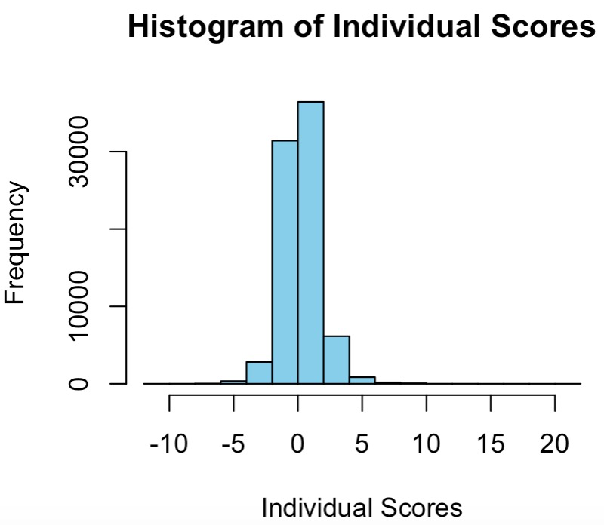
Causal Forest for Scoring and Targeting
Uplift modeling
Causal Forest
X
√
Causal Forest: a set of random forests designed to categorize customers
Variable Importance: PastPurch is the most important among the 7 variables.
- More efficient for a large number of baseline variables
- No need to define cut-offs for continuous baseline variables
- Fit non-linear relationships between baseline variables and uplift
Individual Score
Targeting Decision
Scoring each consumer according to baseline variables
55.79% of training customer set should be targeted(score > 0)
Comparison of Targeting and Non-targeting groups
For targeting group, all the 4 brands have higher past purchase amount on average, except syrah.
Targeting group has higher past purchasing amount ($65.22 vs $40.15) and more recent last purchase (53 vs. 80 days)
Similar visiting frequency (5 times)
Notes:
We chose causal forest as a tool to categorize customers and set targeting plan. This method has several advantages compared to uplift model, also fits this analysis better…
Based on the variable importance result of 7 variables, past purchase is the most important for purchasing decision, with importance level of 0.3.
After using baseline variables to predict purchase amount of each individual, we then multiplied it with 0.3 (which is the profit margin), and minus the 0.1-dollar cost of email to calculate predicted profit as the individual score. We visualized the result in a histogram. According to the result, the individual scores mostly falls between -5 and 5. 56% of training set has a score greater than zero, thus should be targeted by us.
Last but not the least, we compared targeting and non-targeting groups by summarizing their baseline variables. As for different brands, for targeting group, all the 4 brands have higher past purchase amount on average, except syrah. What’s more, targeting group has higher past purchasing amount ($65.22 vs $40.15) and more recent last purchase record (53 vs. 80 days). This is logical, and further proved the reliability of our analysis. The 2 groups also have common point, both has medium visiting frequency of 5 times.
By using our analysis, our company could increase future profit by targeting digital marketing practices including email campaigns at the right group. That’s all of our analysis. Thank you, now we are open to questions.

Slide 7
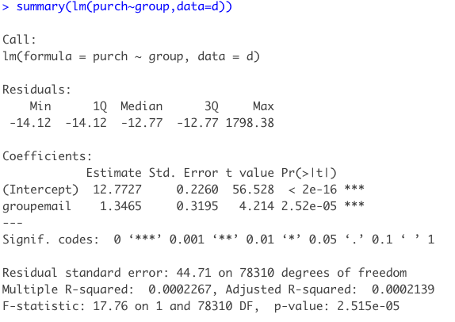
Appendix - Average Causal Effect

Slide 8
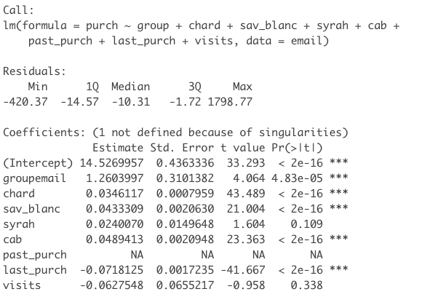
Appendix - Average Causal Effect

Slide 9
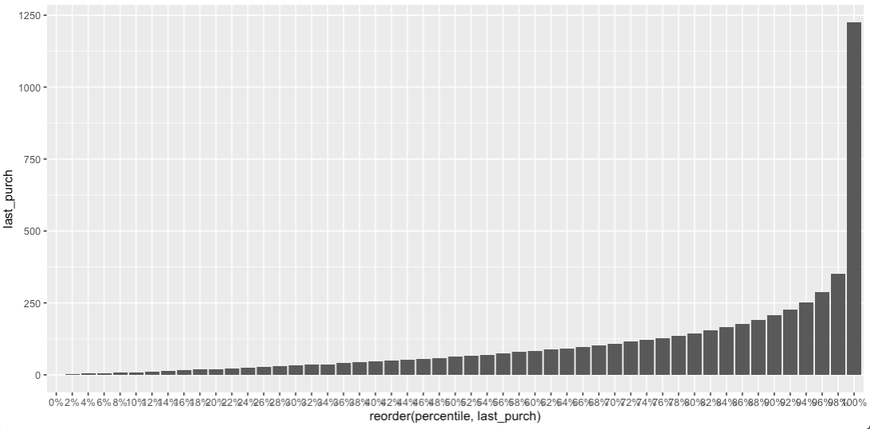
Appendix - Distribution for last_purch

Slide 10
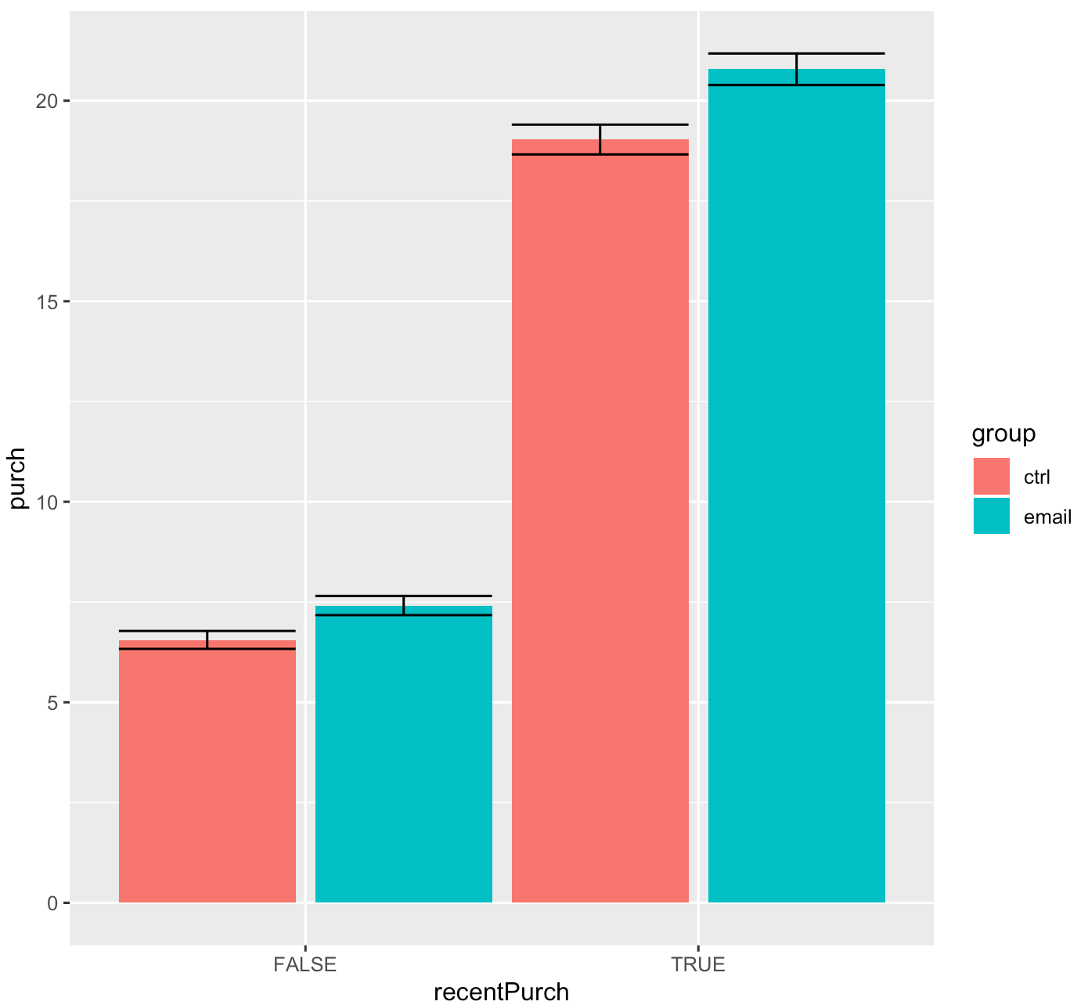
Appendix - Distribution for last_purch

Slide 11
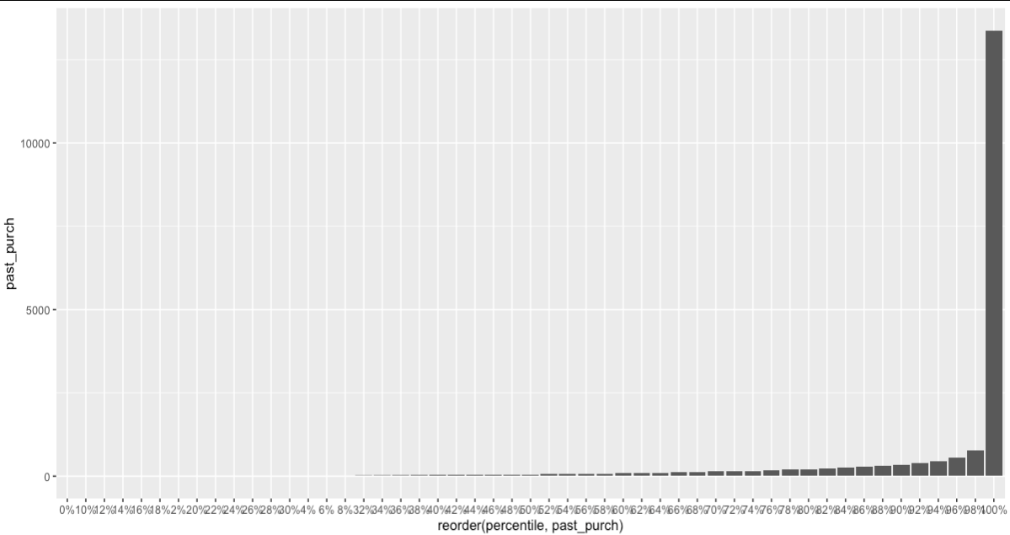
Appendix - Distribution for past_purch

Slide 12
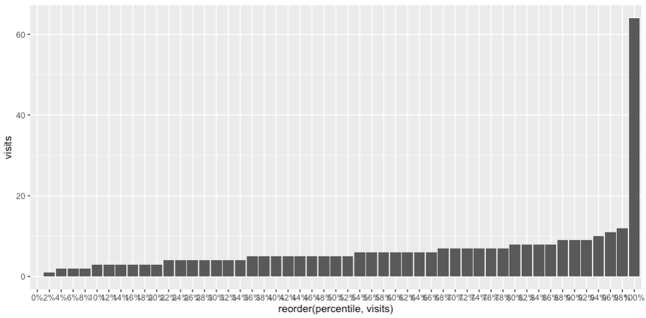
Appendix - Distribution for frequency

Slide 13
Appendix -
Conditional
Causal Effect
Variables | Interactions | coef | P value
Chard | purch_chardFALSE:groupemail | 1.1640 | 0.00214 **
 | purch_chardTRUE: groupemail | 1.5945 | 0.00038 ***
Sav_blanc | purch_savFALSE: groupemail | 0.7541 | 0.0461 *
 | purch_savTRUE: groupemail | 2.8045 | 2.56e-06 ***
Syrah | purch_syrahFALSE: groupemail | 1.4687 | 1.56e-05 ***
 | purch_syrahTRUE: groupemail | 0.4148 | 0.658
Cab | purch_cabFALSE: groupemail | 1.0865 | 0.00406 **
 | purch_cabTRUE: groupemail | 1.9483 | 0.00108 **

Slide 14
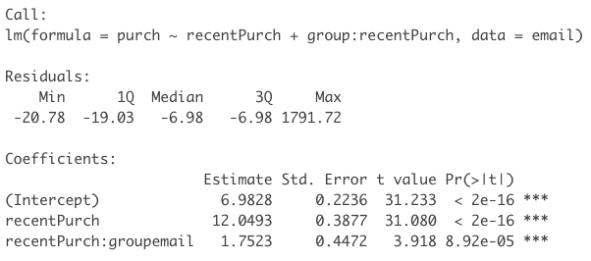
Appendix - Conditional Causal Effect
(Recent Purchase)

Slide 15
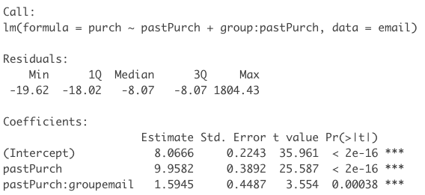
Appendix - Conditional Causal Effect
(Past Purchase)

Slide 16
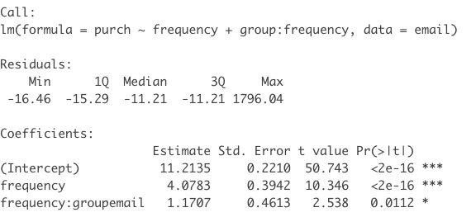
Appendix - Conditional Causal Effect
( Frequency)

Slide 17
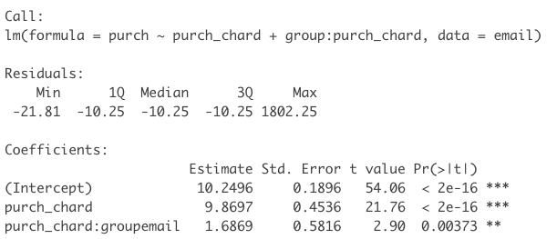
Appendix - Conditional Causal Effect
( Chard)

Slide 18
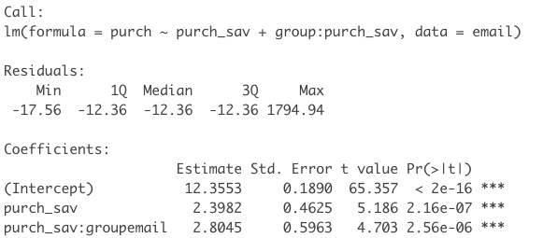
Appendix - Conditional Causal Effect
(Sav)

Slide 19
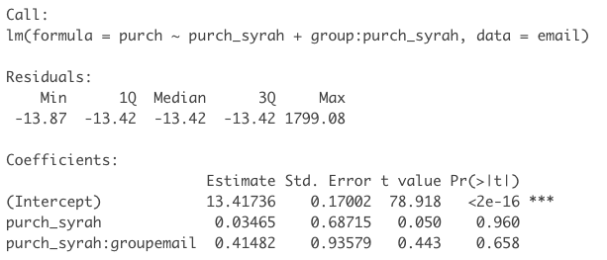
Appendix - Conditional Causal Effect
(Syrah)

Slide 20
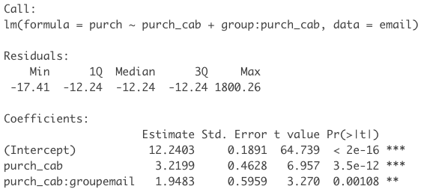
Appendix - Conditional Causal Effect
(cab)

